Slide 1
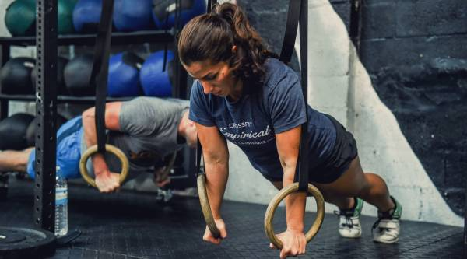
MUSCLEHUB A/B TEST
BY OLANIKE ADEOYE

Slide 2
ABOUT THE PROJECT
MuscleHub is a fancy gym
Currently, when a visitor to MuscleHub is considering buying a membership, he or she follows the following steps:
Take a fitness test with a personal trainer
Fill out an application for the gym
Send in their payment for their first month’s membership
This data analysis is created to carry out an A/B test between two groups, Group A who has been given a fitness test, and group B who wasn’t.

Slide 3
DATASET
Dataset to be used was provided by the manager of MuscleHub as csv files.
The dataset will be worked upon in the Python 3 environment, using jupyter notebook. The results of the test are verified using a relevant statistical hypothesis testing - ChiSquare.
The population of the two groups are presented in the next pie chart.

Slide 4
Percent of visitors who apply
There is a significant difference in percentage of group A or group B who picked an application form.

Slide 5
Percent of applicants who purchase a membership
There is no significant difference in percentage of group A or group B who picked up application who finally purchased membership.

Slide 6
Percent of visitors who purchase a membership
There is a significant difference in percentage of group A or group B who visited who finally purchased membership

Slide 7
Recommendations
MuscleHub should find out what part of the fitness test may discourage visitors from picking up application.
MuscleHub should consider if continuing the Fitness test brings a certain population who wouldn’t buy membership but for the test.
This would determine if running a fitness test is a worthwhile investment for the company.

